Slide 1
Hello year 9
Hope you are all well
This task is for 3 weeks starts 29Th June and deadline is 17th July
Read each slide complete the task and produce a fact file on each setting.
Fact file needs to include:
All information and pictures
More detail on last 2 slides.

Slide 2
Key
Read
Research
Task

Slide 3
Child minder
Research Childminder

Slide 4
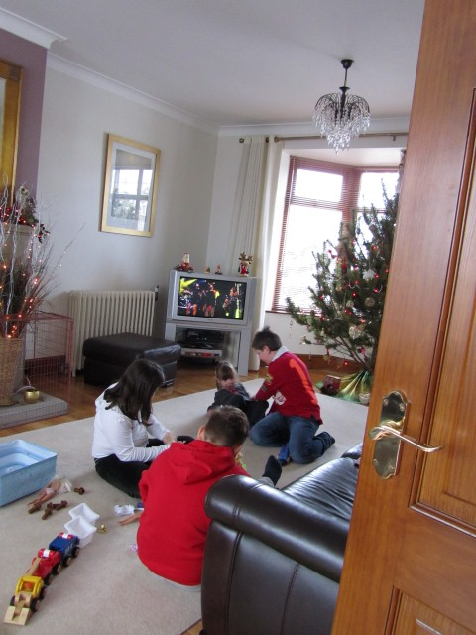
Child minder
Works in their own home
Small number of children
Care provided for children of working parents

Slide 5
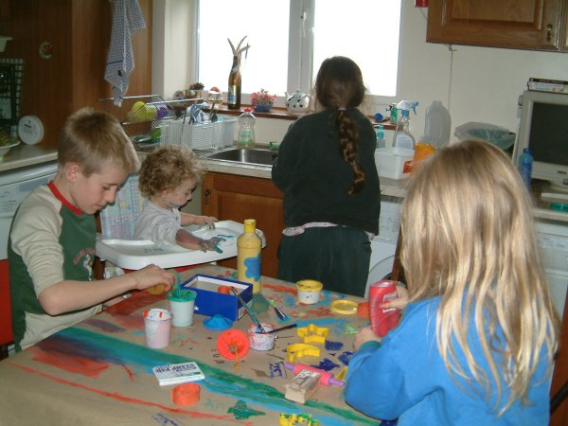
Child minder
May take children to and from school or nursery
Children play in the home or garden
Toys and games books – as you would have at home
May do activities like cooking or painting or play dough
Children from birth – to any age (normally under 11)

Slide 6
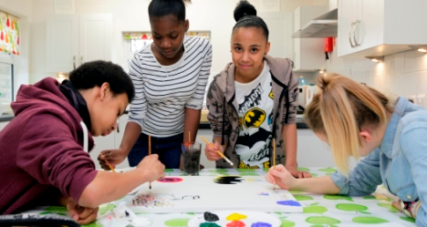
The role of a Child minder
Provide care for children

Slide 7
Day nursery
Research Day nursery

Slide 8
Day nursery
Care and education for children aged birth to 5
Activities like sand water, art activities, construction toys, home corner , outdoor play area with bikes climbing frames, slides etc.
Whole group story/circle times/ singing and music sessions

Slide 9
Day nursery
Prepares children for school routine and socialisation
Has meals provided and sleeping areas for younger children
Purpose built building with qualified staff
Follows 7 areas of learning of the EYFS

Slide 10
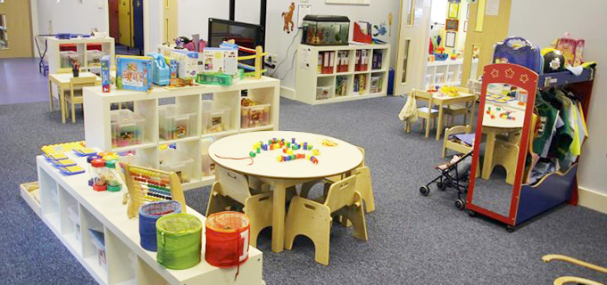
The role of a Day nursery
Education – home corners
Care

Slide 11
Mother and Toddler group
Research Mother and Toddler group

Slide 12
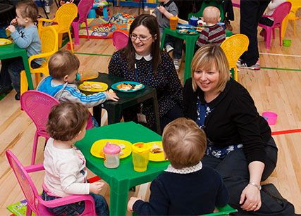
Mother and Toddler group
Usually for children aged from birth to 3
Mothers can chat and have a cup of tea or coffee while children play
Takes place in school or community halls- not purpose built

Slide 13
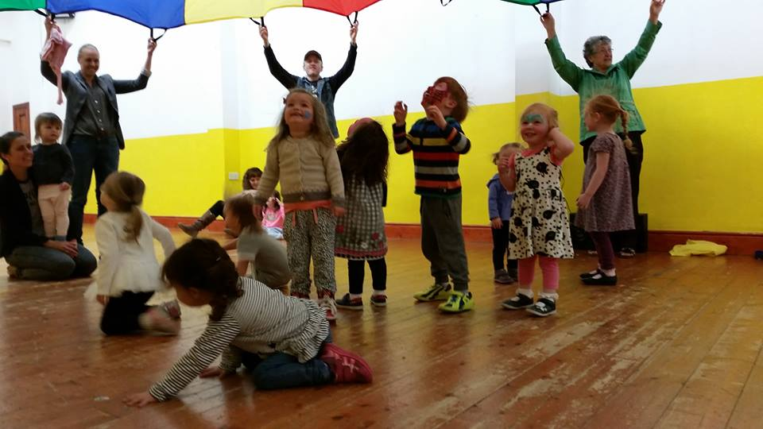
Mother and Toddler group
Has selection of toys like jigsaws, building blocks, shape sorters soft toys, baby books
Run by volunteers but not staffed as such , mothers supervise their own children , not a formal setting
Aimed at socialisation for children rather than education

Slide 14
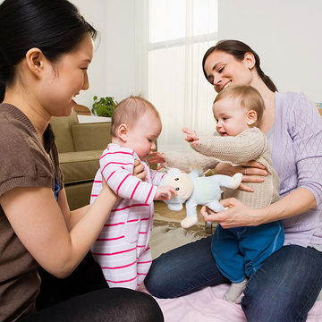
The role of Mother and Toddler group
Socialisation

Slide 15
Task – fact file
Fact file on:
Child minders/
Day nursery/
Mother and toddlers groups.
What needs to be included for each setting:
Information about each setting
Pictures
Answers to the following questions
Last weeks work will also help with this task

Slide 16
Questions
What is their role? Care/ education?
What happens there to fulfill the role of education or care?
Who provides the care or education?
How many children are within each setting?
How do they care /education the children?
Where do they do this?
What age is this for?

