Slide 1






JLA House Update – Week Starting 1st November 2021
Remember – 10 points for every entry of all competitions!
Live Competitions This Week
Year | Competition | Who/Where | When | Slide
All Year Groups | Poppy Making | Miss Southworth KWB 103 | This Thursday (11th November) After School | 4
Extra Curricular Timetable
Slides : 8-9
An exciting Residential Trip is happening next summer, open to Y7 and 8 students, see slide 4 for details!
At Home Competitions This Week
Year | Competition | Who/Where | Deadline | Slide
All Years | Design a Flag for Antarctica | Ms Stead - 307 | 12th November | 6
SMSC = Remembrance Day 11th November Slide 7
FIFA Tournament
See Slide 5 !!
JLA Children In Need 2021 – Next Week !
BBI Poster Comp Winners !
1st: Hazera Begum
2nd: Maisha Rahman
3rd: Tanisha Duggal

Slide 2

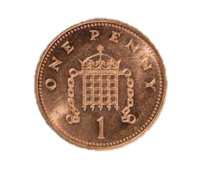









For this Years charity in need, help your house by bringing in as many pennies as you can. Raise as much pennies and help your house win this years Penny War.
Come one and all to the Cake sale. Help us raise as much money by buying cakes which all goes towards helping kids who desperately need our aid. Prices range from £1 to 50p

Slide 3








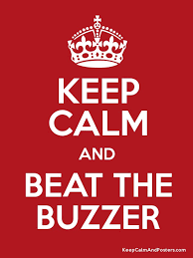




The time of year has come around for Children In Need and the time has come for another event. Bring your £1 or 50p and come down, have some fun and help us raise money for those children who need our help.

Slide 4

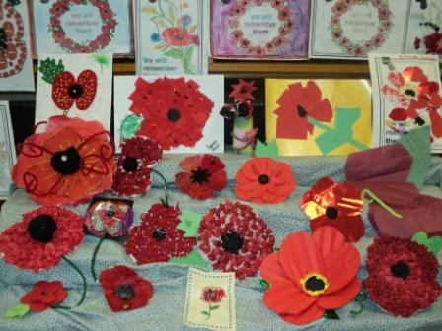
Poppy Making Competition
To honour those who serve to defend our democratic freedoms and way of life, there will be a poppy making competition taking place in Room 103 on Thursday, 11th November.
Everything will be provided for you, so all you have to do is bring a bit of creativity! Prizes will be given for the top three designs.
Here are some examples of what you can make:
See you on Thursday!

Slide 5

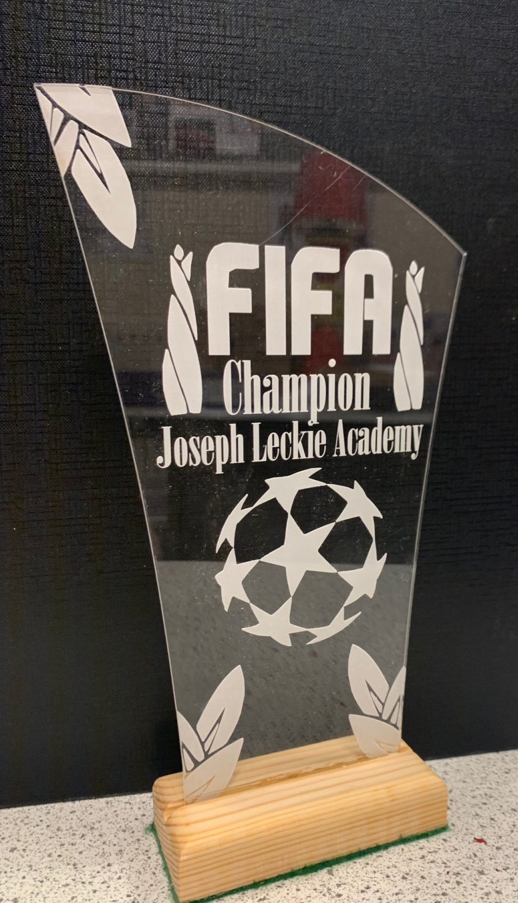

FIFA 22 Tournament
Register with Mr Potter, Mr Giles or Mr Barron
It will be taking place in Room 204
Boys and girls, novices and experts all welcome!
Play as a team of two or on your own
Year 7 – 17th November
Year 8 – 24th November
Year 9 – 1st December
Year 10 – 8th December

Slide 6
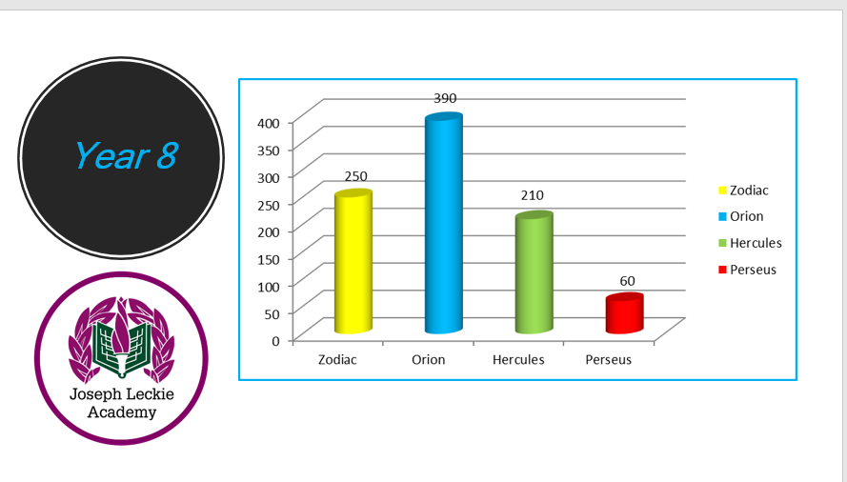
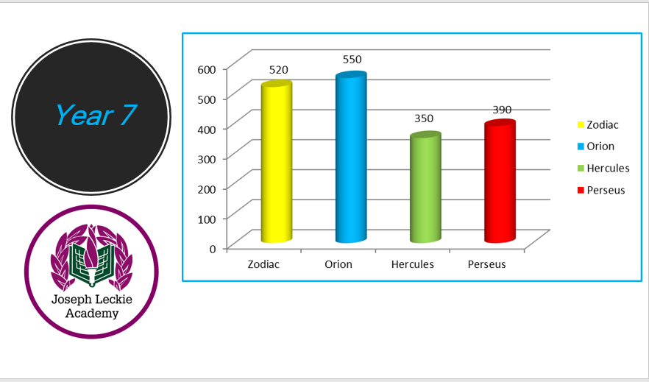
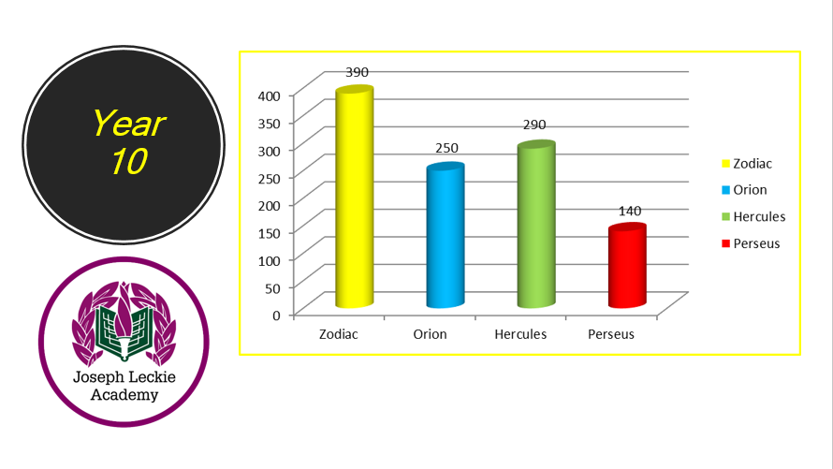
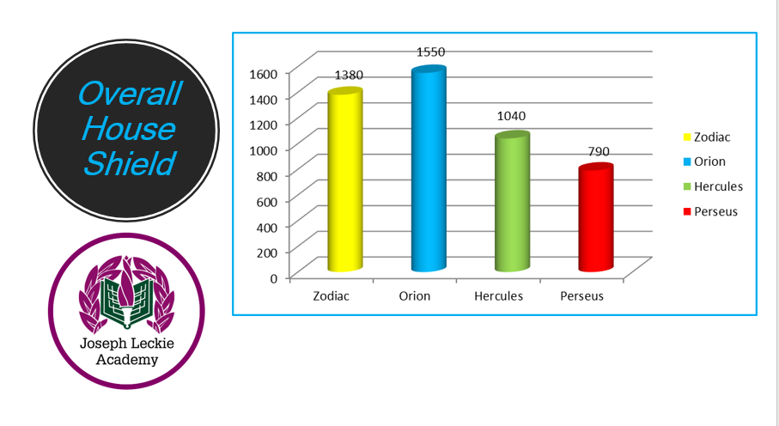
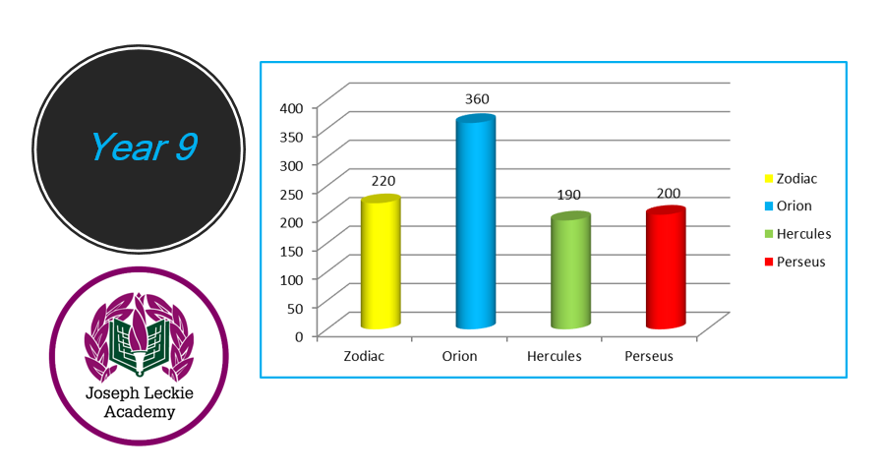
A New Points Total has Arrived…
Remember- It’s not too late to keep getting involved and winning points for your house!
40 points for first
30 points for second
20 points for third
10 points for any competition entry!

Slide 7
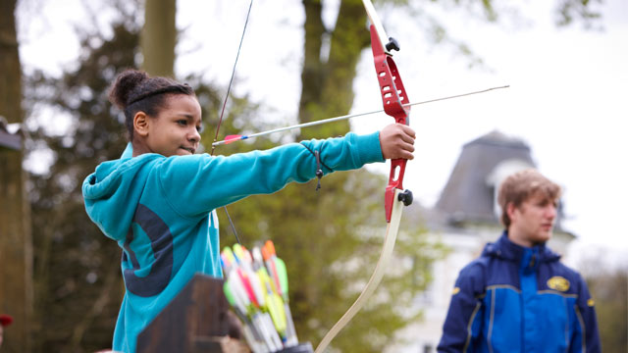

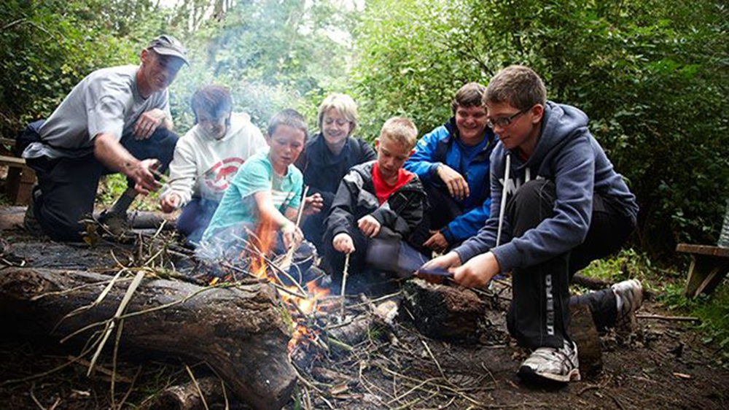
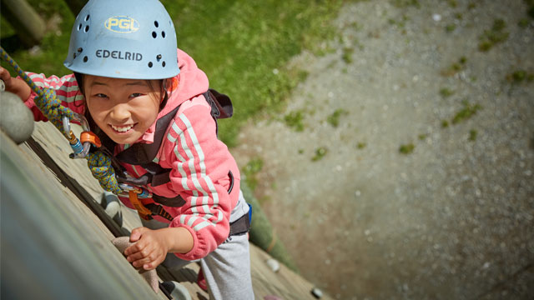
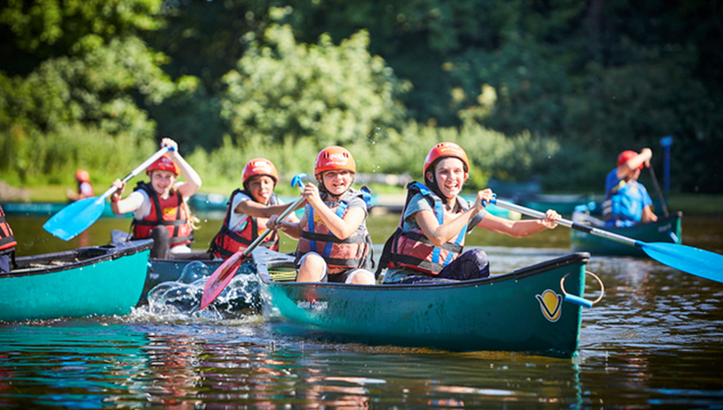

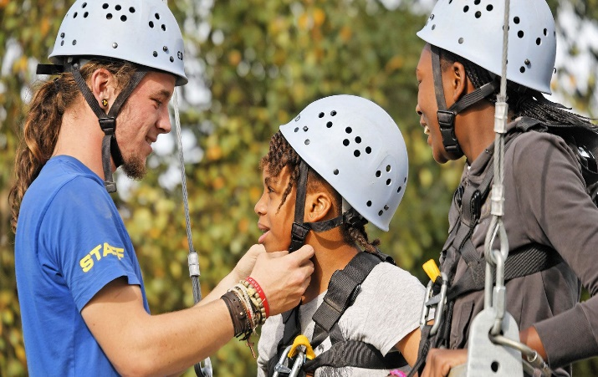
KS3 Residential Trip 2022
Letters with all details available from Ms Stead (307 KWB)
100 places between Y7 and 8 – trip open to girls and boys
First come first served – get your permission slips signed and in quickly!
Places awarded on a first come first served basis
Wonderful Opportunity not to be missed
More information from Ms Stead (307 KWB)
Two nights away staying in Shropshire.
Loads of fun activites such as climbing, caving, quad biking, raft building, orienteering, team building, quizzes.
Leaving Monday 30th May returning Wednesday 1st June 2021

Slide 8




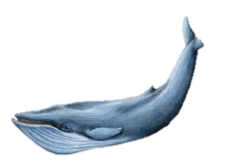
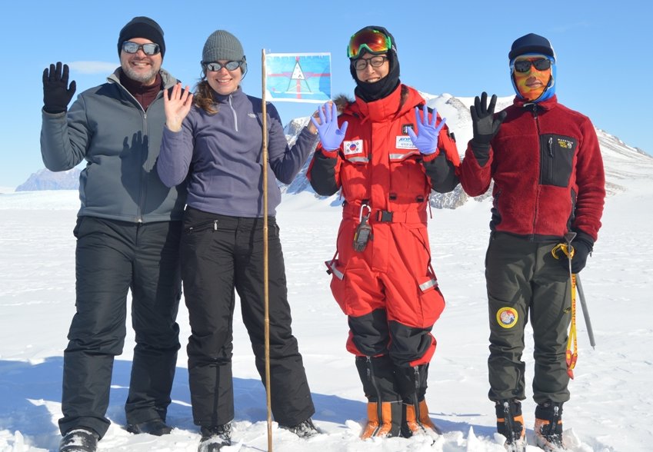
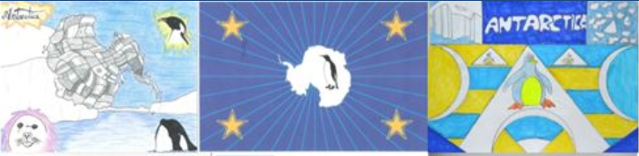
Imagine designing a flag that will be taken to Antarctica by a scientist. Now is your chance!
House Competition to Design a flag for Antarctica
Year 7 & 8
Year 7 & 8
Your flag design needs to:
Be A4 size
Include the Joseph Leckie Academy Logo
Be a simple design that shows up well against the snow and ice in Antarctica
Use no more than 3 colours
Think about the meaning in your flag – the images, colours or patterns should relate to what it symbolises (what animals, plants etc could you include in your design?)
WINNING DESIGN WILL BE TAKEN TO ANTARCTICA!
1st 2nd and 3rd place will receive a prize
House Points/Vivos for everyone
who enters
Closing date: 12th November
Designs should be handed or emailed to Ms Stead room 307 KWB v.stead@josephleckieacademy.co.uk

Slide 9
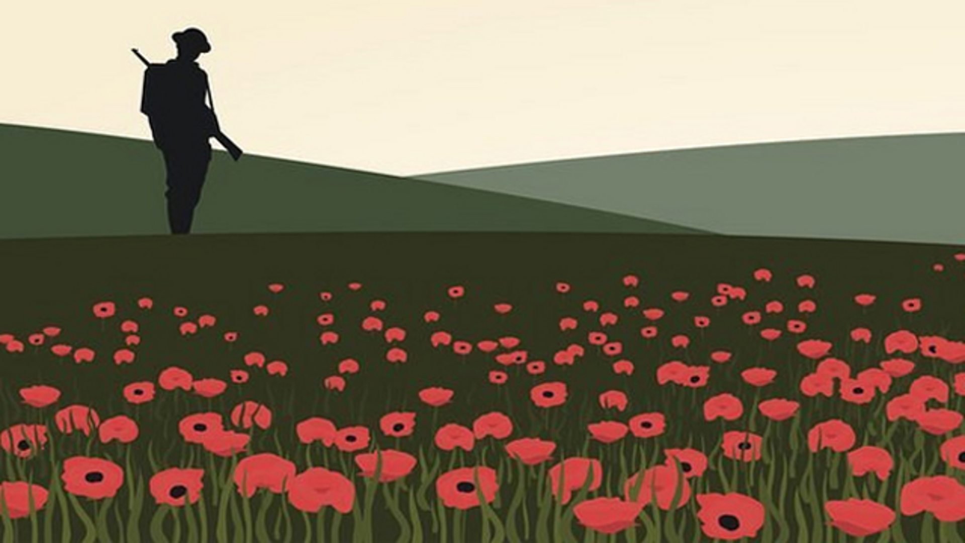

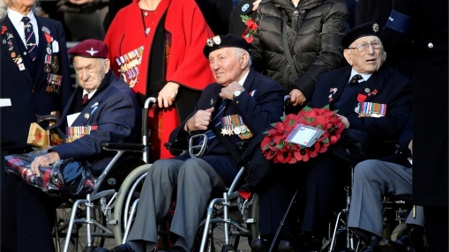
11th November 2021 – Armistice Day
Social and Moral- The Armistice, an agreement to end the fighting of the First World War as a prelude to peace negotiations, began at 11am on 11 November 1918.
The National Service of Remembrance at the Cenotaph in London is held on Remembrance Sunday, the closest Sunday to 11 November. The service is attended by senior members of the Royal Family, including Her Majesty the Queen, HM Government and usually features a March Past involving 10,000 veterans. This year's Remembrance Sunday will take place on 14 November.
How do we remember those who have died due to war and conflict?
Even though the event started to remember those in the first world war, it is also to remember those who have died since in all global conflicts. Watch the video to see what it means to others…
The poppy is a well-known and well-established symbol. It was used due to the poppies referenced in the poem Flanders fields. It is used a symbol of hope for a peaceful future.
A traditional 2 minutes silence at 11am on the 11/11 is held. This is a time to reflect and pay gratitude to those who have scarified their lives to ensure we live in safety.
What does remembrance mean for you?

Slide 10


Extra-Curricular Timetable – See Ms Stead | Extra-Curricular Timetable
Homework Help Club - Library – Every Day 8.00-8.35am and 2.50-4pm ALL YEARS | Homework Help Club - Library – Every Day 8.00-8.35
 | Monday | Tuesday
Before School 8-8.30 | Football Y9 – Sports Hall | Chess – Y12-13 S3/4 Cricket – All Years- Sports Hall
After School 3-4pm | Art Club – Y7-8 – Starting Soon Book Club – All Years – E09 Debate Club Y9-13 – EO8 Drama Club - All Years - Drama Studio Football – 6th form Boys – Sports Hall History Club – All Years – KWB 203 | 5 a Side Football – Y11 – Sports Hall AfterMath Club - M4 Debate Club – Y7-8 – EO8 French – Y9-11 – MFL2 French Club - Y7-8 – MFL1 Maths Intervention – AS Level - M09 Swimming Club – Y7-8 BOYS – Pool Trampolining – All Years – Gym

Slide 11
Extra-Curricular Timetable | Extra-Curricular Timetable
Homework Help Club - Library – Every Day 8.00-8.35am and 2.50-4pm ALL YEARS | Homework Help Club - Library – Every Day 8.00-8.35
 | Wednesday | Thursday | Friday
Before School 8-8.30 | Basketball – Y10-11 – Sports Hall Eco Club – All years- KWB 307 | Table Tennis – All Years Gym | Basketball Y7-8 Boys and Girls - Sports Hall Mindfulness Club – All Years – E4
After School 3-4pm | Boxercise – All Years – Drama Studio (After October half term) Football – Y7-8 GIRLS – Sports Hall Chill Out Club – All Years – KWB 206 | Chess Club – Y11 - S3 Football Tournament – See updates for Yr Groups – Sports Field | Badminton – Y9-11 – Sports Hall D of E - Sports Hall Swimming Club – Y7-8 GIRLS – Pool

Slide 12









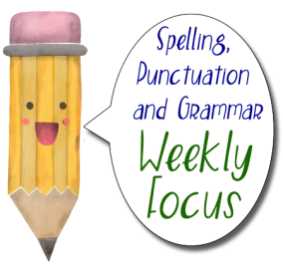


To see more follow this link to the Literacy page on SharePoint

