Slide 1
JLA House Update – Week Starting 1st November 2021
A 2021-22 First Points Total is on Slide 2
Extra Curricular Timetable
Slides : 8-9
Remember – 10 points for every entry of all competitions!
SMSC = Celebrating Diwali
Slide 7
Live Competitions This Week
Year | Competition | Who/Where | When | Slide
All Year Groups | Scrabble Competition | Mr Potter in T6 | This Tuesday (2nd November) After School | 3
An exciting Residential Trip is happening next summer, open to Y7 and 8 students, see slide 4 for details!
At Home Competitions This Week
Year | Competition | Who/Where | Deadline | Slide
All Years | Careers Behind the Camera | Ms Ahmed – Room 101 | 5th November | 5
All Years | Design a Flag for Antarctica | Ms Stead - 307 | 12th November | 6
Coming Soon...
Black Lives Matter Competition- Judging this week and winners announced next week! Any last minute entries, send up to Mr Barron!

Slide 2
A New Points Total has Arrived…
Remember- It’s not too late to keep getting involved and winning points for your house!
40 points for first
30 points for second
20 points for third
10 points for any competition entry!

Slide 3
Tuesday After School- T6 (Mr Potter’s Room)
All year groups welcome!

Slide 4
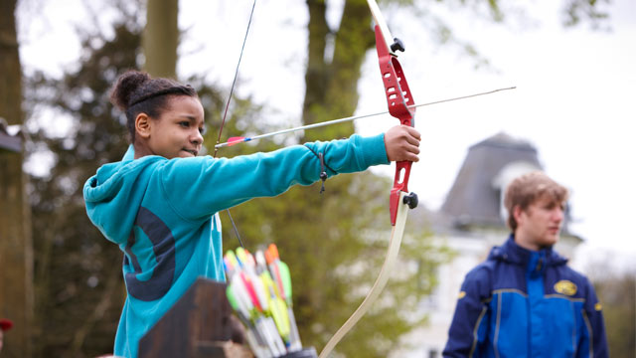
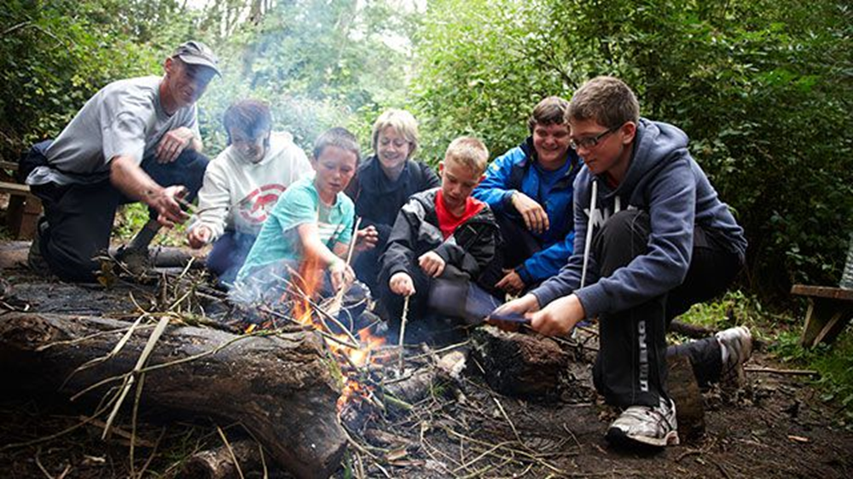
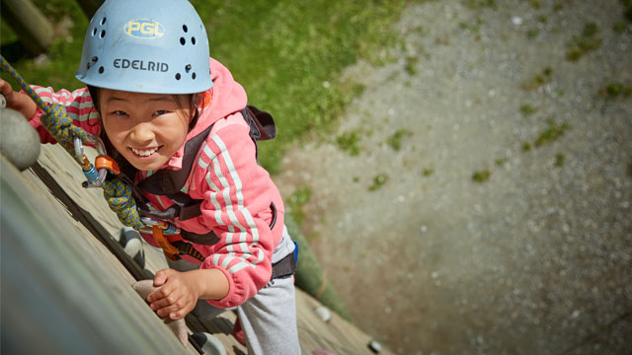
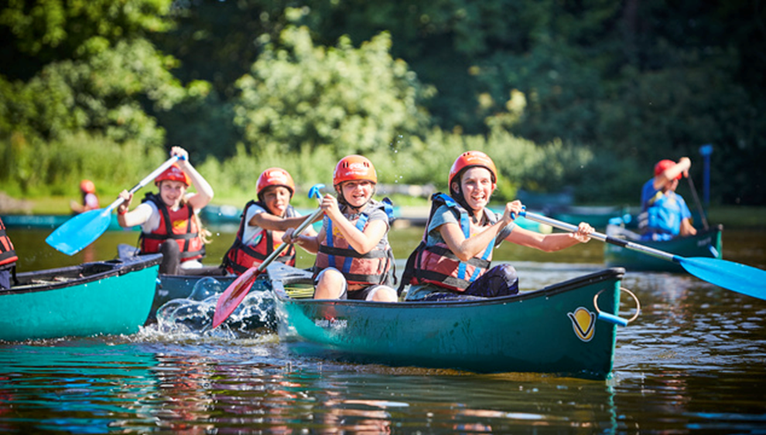
KS3 Residential Trip 2022
Letters with all details available from Ms Stead (307 KWB)
100 places between Y7 and 8 – trip open to girls and boys
First come first served – get your permission slips signed and in quickly!
Places awarded on a first come first served basis
Wonderful Opportunity not to be missed
More information from Ms Stead (307 KWB)
Two nights away staying in Shropshire.
Loads of fun activites such as climbing, caving, quad biking, raft building, orienteering, team building, quizzes.
Leaving Monday 30th May returning Wednesday 1st June 2021

Slide 5
Enter this competition for the chance to win an official No Time To Die merchandise bundle
Ten national winners could win selection of official No Time To Die merchandise, comprising wireless headphones, a power bank, an umbrella, weekend bag, and an Aston Martin key chain.
Development
Production Management
Post-Production
Craft
Technical
Careers Behind the Camera
Students need to write a letter imagining they’re applying to a Universal film production.
Addressing the producer, pupils need to explain which behind-the-scenes department they’d like to work in and why.
You need to pitch persuasively, making sure to mention the skills they’d bring to the role.
The winners for this competition will be selected by Into Film, Universal and EON.
Collect an entry form from
KWB 101
Ms Ahmed
Deadline
Friday 5th November

Slide 6
Imagine designing a flag that will be taken to Antarctica by a scientist. Now is your chance!
House Competition to Design a flag for Antarctica
Year 7 & 8
Year 7 & 8
Your flag design needs to:
Be A4 size
Include the Joseph Leckie Academy Logo
Be a simple design that shows up well against the snow and ice in Antarctica
Use no more than 3 colours
Think about the meaning in your flag – the images, colours or patterns should relate to what it symbolises (what animals, plants etc could you include in your design?)
WINNING DESIGN WILL BE TAKEN TO ANTARCTICA!
1st 2nd and 3rd place will receive a prize
House Points/Vivos for everyone
who enters
Closing date: 12th November
Designs should be handed or emailed to Ms Stead room 307 KWB v.stead@josephleckieacademy.co.uk

Slide 7
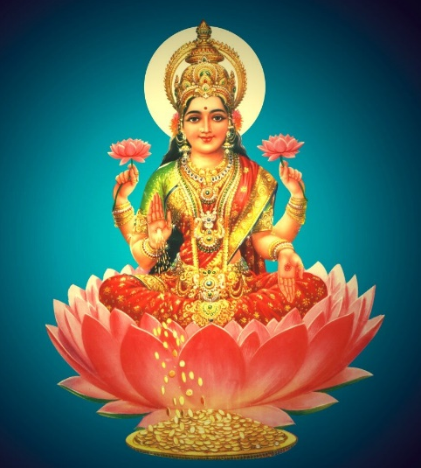
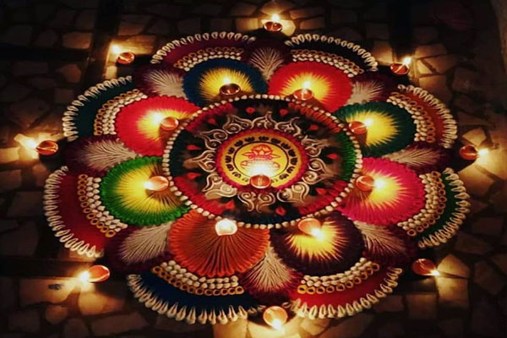
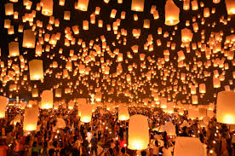
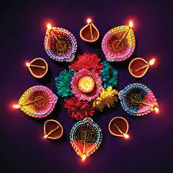
1st November 2021 – Diwali
Spiritual and Cultural - Diwali is also known as the festival of lights and is celebrated by Hindus and is also marked by other religions in India, including Sikhs, Jains, and some Buddhists, this results in around 1 billion people celebrating world wide. This year Diwali will be celebrated on the 4th November.
Diwali symbolises the spiritual “victory of light over darkness, good over evil, and knowledge over ignorance”. It is widely associated with the Goddess Lakshmi, who symbolises three virtues: wealth and prosperity, fertility and abundant crops, as well as good fortune.
How do people celebrate?
For those who are celebrating this week…
Lighting lamps is an important part of the celebration, the lights are believed to help guide Lakshmi into people’s homes bringing prosperity for the new year.
For Hindus, the day is in honour of deities Rama and Sita’s return to Ayodhya after their 14-year exile. It also is a celebration of the day Goddess Durga destroyed a demon called Mahisha.
Sikhs, however, often now use the day to celebrate the release of the sixth guru Hargobind Singh from prison in 1619.
Jains celebrate the moment their founder Lord Mahavira reached a state called Moksha, which is eternal bliss or nirvana.
Rangoli is a popular Diwali tradition –– beautiful patterns made using colourful powders, flour, rice and flowers. People draw rangoli on the floor by the entrance of their homes to welcome the gods and bring good luck!
From everyone at Joseph Leckie
But it’s not just about lights and legends –– Diwali is a time to have fun with friends and family! People exchange gifts and sweets, enjoy delicious feasts, watch firework displays and wear new clothes. It’s a time to clean and decorate your home, too.
Test your knowledge of Diwali here!
https://www.bbc.co.uk/cbbc/quizzes/diwali-quiz

Slide 8
Extra-Curricular Timetable – See Ms Stead | Extra-Curricular Timetable
Homework Help Club - Library – Every Day 8.00-8.35am and 2.50-4pm ALL YEARS | Homework Help Club - Library – Every Day 8.00-8.35
 | Monday | Tuesday
Before School 8-8.30 | Football Y9 – Sports Hall | Chess – Y12-13 S3/4 Cricket – All Years- Sports Hall
After School 3-4pm | Art Club – Y7-8 – Starting Soon Book Club – All Years – E09 Debate Club Y9-13 – EO8 Drama Club - All Years - Drama Studio Football – 6th form Boys – Sports Hall History Club – All Years – KWB 203 | 5 a Side Football – Y11 – Sports Hall AfterMath Club - M4 Debate Club – Y7-8 – EO8 French – Y9-11 – MFL2 French Club - Y7-8 – MFL1 Maths Intervention – AS Level - M09 Swimming Club – Y7-8 BOYS – Pool Trampolining – All Years – Gym

Slide 9
Extra-Curricular Timetable | Extra-Curricular Timetable
Homework Help Club - Library – Every Day 8.00-8.35am and 2.50-4pm ALL YEARS | Homework Help Club - Library – Every Day 8.00-8.35
 | Wednesday | Thursday | Friday
Before School 8-8.30 | Basketball – Y10-11 – Sports Hall Eco Club – All years- KWB 307 | Table Tennis – All Years Gym | Basketball Y7-8 Boys and Girls - Sports Hall Mindfulness Club – All Years – E4
After School 3-4pm | Boxercise – All Years – Drama Studio (After October half term) Football – Y7-8 GIRLS – Sports Hall Chill Out Club – All Years – KWB 206 | Chess Club – Y11 - S3 Football Tournament – See updates for Yr Groups – Sports Field | Badminton – Y9-11 – Sports Hall D of E - Sports Hall Swimming Club – Y7-8 GIRLS – Pool

Slide 10
Posponed this Week
Back Soon Though!
au revoir jusqu'à ce que nous nous rencontrions à nouveau

Slide 11
To see more follow this link to the Literacy page on SharePoint

