Slide 1
HOME SCREEN
Click here

Slide 2
Please use your school email address
If you DO NOT know your password, reset by clicking here

Slide 3
How to add your confirmed Work Experience Place
When you have found your employer and secured a placement, you can start the process of recording it on Unifrog.
Once you are on Unifrog, scroll down until you find the Placements Tool box (purple) click on “Go to tool”.

Slide 4
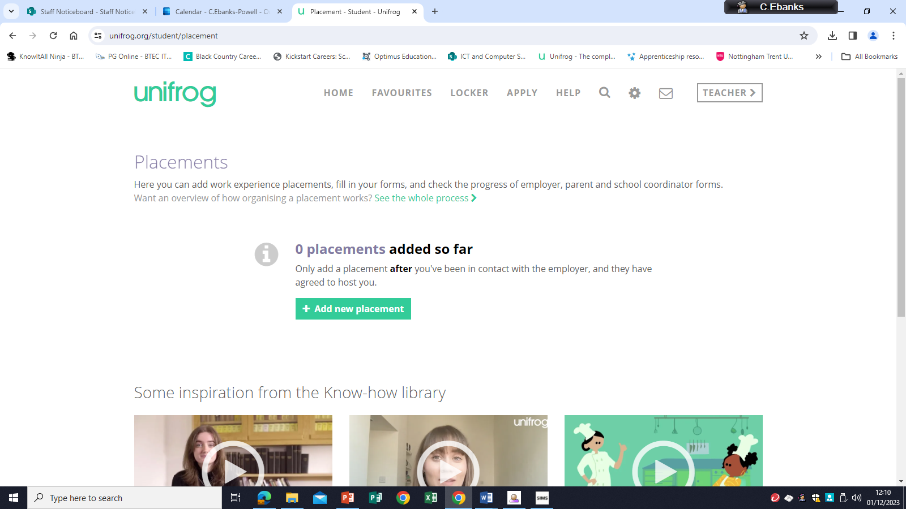
click on
“add new placement”

Slide 5
Fill in the Student
Initial form by selecting
from the drop down options
Or typing in the information
requested.
Fill these in as shown

Slide 6
Fill in the remainder of the Form

Slide 7
To complete the
process you MUST:
Read the “Do you agree to”
section and click agree
Click on the box in the
“Form Finished?” section
notify the employer
Click green button
at the bottom of the page to
“Add placement”

