Slide 1
Nature v. nurture
Start 29th June – Deadline 17th July
Work your way through the powerpoint. Some slides have task, this is indicated with this picture -
Some slides have videos to watch or information to read this is indicated -
Then complete the final task a report.
Email all tasks and report back to:
Mrs Matthews by 17th July.

Slide 2
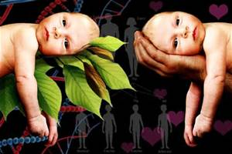
Nature and nurture
Individual task
Can you write an explanation of what the difference is between nature and nurture

Slide 3
Key terms:
Nature:
Genetic and biological influences
Nurture:
Social, economic and environmental influence
Fundamentally the argument is: which is the stronger influence on personal development, nature (Genetics) or nurture (Environment)

Slide 4
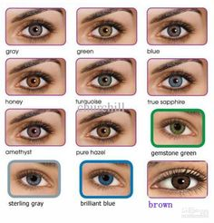
Nature

Slide 5
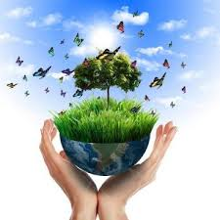
Nurture

Slide 6
Observation & Imitation of Role Models

Slide 7
Nature
Biological programming
Genetics are our blueprint they contain our genetic code.
The question is: do we inherit our intellect, behaviour and diseases?
Behaviour is a result of your genes
It’s down to biology
Can’t help it
Criminals are born that way
Intelligence – born clever/not clever

Slide 8
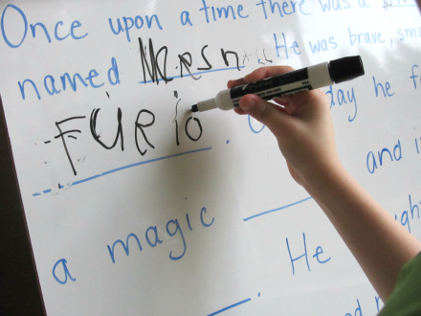
Nature
Characteristics and differences not observed at birth but which emerge later in life are referred to as Maturation.
Assumptions that individuals have a inner biological clock that determine when and at what rate physical development will progress.

Slide 9
Nurture
Behaviour is a result of your environment
Genes have little or no effect
Socialisation makes you into the person you are
Intelligence – educational success lies within social environment

Slide 10
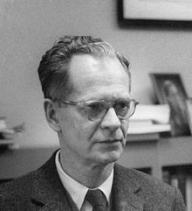
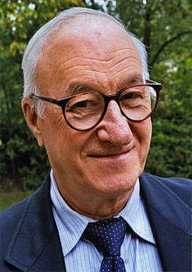
Nurture
Some theorists sees the mind as a ‘blank slate’
Thus: behaviour, knowledge and skills are a result of social learning
BF Skinner was a nurture theorist who argued that language is learned from others

Slide 11
Research
Task
Research the nature v nurture debate
Read about stories related
This will help you with your final task

Slide 12
Nature v. nurture
Watch the following clips carefully –
Genie Wiley
https://www.youtube.com/watch?v=VjZolHCrC8E
The David Reimer Story
https://www.youtube.com/watch?v=9LQBcAVghu4
If links don’t work, go onto YouTube and search for - David Reimer and Genie Wiley
How do the clips you have just watched compare?

Slide 13
Task - report
Your task is to outline both sides of the nature and nurture debate.
Explain what nature means
Explain what nurture means
Summarise what you watch about Genie and David – explain how these link to this debate.
Make a conclusion based on all your research to decided nature / nurture or BOTH. Justify your answer.

Slide 14
Once complete email Mrs Matthews
Deadline 17th July

